Slide 1
Young Food Writer of the Year 2021
Notes:
New title - Young Food Writer of The Year 2020
Remove Pink Lady logo and replace with new logo from TWJ I will send to you
Keep The Guild logo
Remove all pink ! Lets go purple instead!

Slide 2
What is the Guild of Food Writers?
A group of people who are passionate about FOOD
We write about all aspects of food
Recipes
Different ways of eating
Restaurant reviews
Current affairs – have you ever wondered why apples float?
Members include Mary Berry
Notes:
Keep same – remove pink

Slide 3
The Week Junior
Notes:
Young Food Writer Competition
I will send new visiual

Slide 4
2018 Competition Video
Notes:
Keep

Slide 5
Why should you get involved?
We want to read YOUR story
Your opinion matters
Win fabulous prizes for you and your school or organisation
Help kick start your career as a writer
It’s fun!
Notes:
keep

Slide 6
Prizes up for grabs
An invite to the Guild of Food Writers’ virtual tea party where you’ll have the chance to speak to the judges – with a hamper of tea and cakes sent in the post to enjoy
Recognition of your outstanding work will be featured at the Guild of Food Writers Awards Ceremony on Wednesday 23 June
A £100 book token and certificate per category winner
For the 10 and under and 11-14 category winners: The winners’ stories will be featured in The Week Junior, and they'll also win a year's subscription to The Week Junior
For the 15-18 category winner: The winner’s story will be featured by delicious. magazine.
One runner up per age group will win a £25 book token
Notes:
Winner’s Tea Party in London June 2020 – meet the judges
£100 book token
Bundle of cookery books
See your name in print! The Week Junior
A year’s subscription to The Week Junior or delicious. magazine
Your story published on The Week Junior and the Guild’s website
Announcement in the Guild of Food Writers’ Awards brochure

Slide 7
2021 theme: Food Discovery
How you discovered your favourite or least favourite food
Maybe you discovered how a certain food was grown
What a food looks like in its natural form
You may have discovered new flavours, textures or aromas
Opportunities to discover new foods are all around us every day, and trying something new can be exciting – even if you don’t like it at first! We want to hear all about your most memorable food discovery.
Notes:
2020 theme : Food and Heroes

Slide 8
How to enter…
Writing Tips
Remember to base your story on this year’s theme – Food Discovery
Bring in your own experiences – how it looks, feels, tastes, sounds – to bring your story to life
Plan – whether it’s fact or fiction – ask yourself
Where does the story take place?
Who is in it?
What is going to happen?
Have fun ! Passionate writing always shines through
10 yrs (and under)
250 words
11-14 yrs
500 words
15-18 yrs
750 words
Notes:
This can stay the same but no pink please!
Just change reference to theme to Food and Heroes

Slide 9
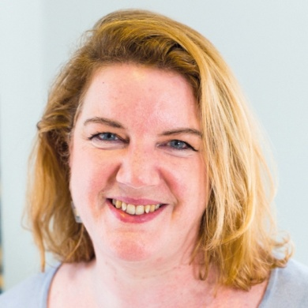
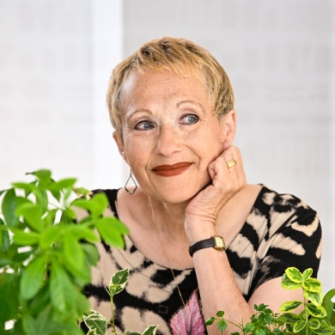
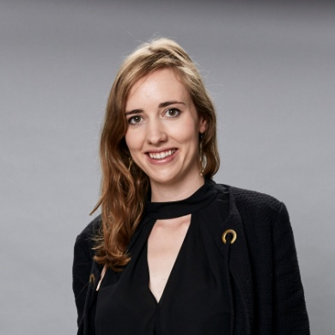
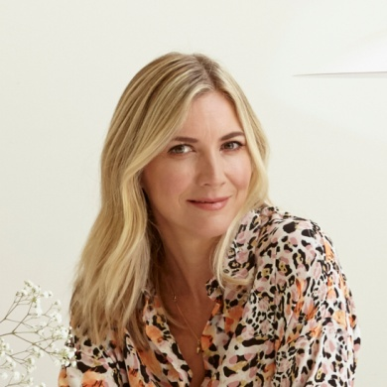
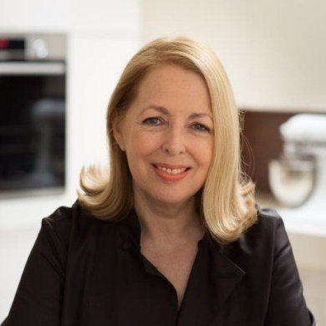
Meet the Judges
Karen Barnes, editor of award-winning delicious. magazine
Sherry Ashworth, author for children and young adults
Felicity Capon, editor of The Week Junior magazine
Samuel Goldsmith, food editor and Guild Vice-President
Lisa Faulkner, cookbook author, actress and presenter
Stefan Gates, author, documentary maker and TV presenter
Ben Isaacs, Features Editor of The Week Junior magazine
Lorna Wing, cook, food writer, cookery teacher
Kalpna Woolf, TV producer and cookery book writer
Notes:
I will ask my colleague to do this as he has all the photos

Slide 10
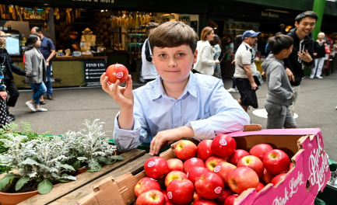
Get involved
Visit The Week Junior website. Competition closes Friday 30 April
See the Guild of Food Writer’s website
Talk to your teacher or leader
Tell your family and friends
Noah Eyre, 2019 winner, 11-14 years old age group: ‘I’ve never entered a writing competition before … If you enjoy writing I would say just have a go … you never know you could be a winner like me. I won some brilliant prizes and met some lovely people. It was a brilliant experience.’
Notes:
Visit The Week Junior website . Competition closes 30th April
Next three points remain the same
Last point – I will provide a quote from a previous winner

